Slide 1
Game Entity – Component - System Design
Dimitris Evgenidis

Slide 2
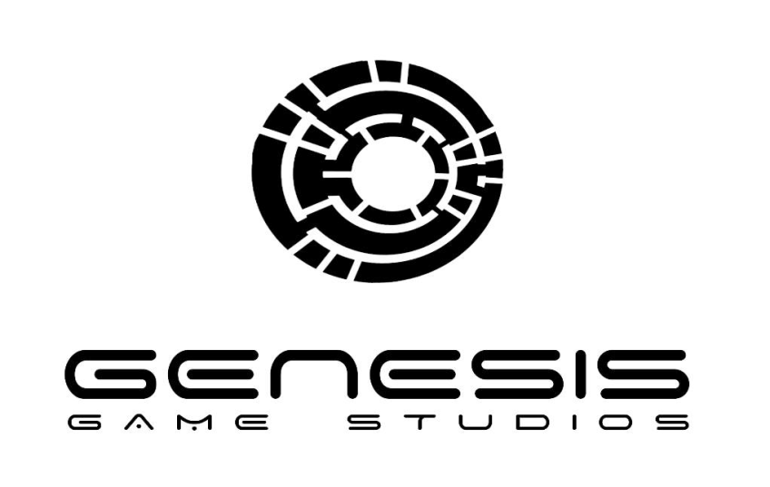
Introduction
Game Programmer at
Genesis Game Studios
UOA – Department of Mathematics
Applied and Computational Mathematics

Slide 3
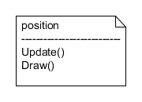
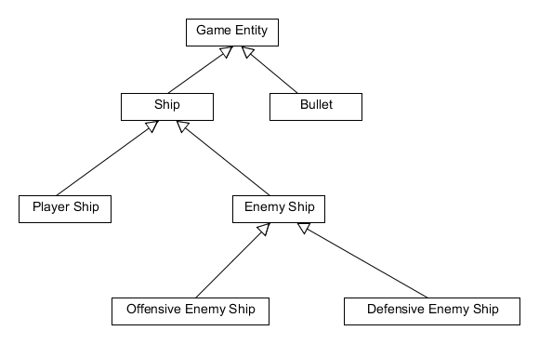
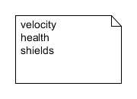
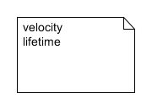
Hierarchy Inheritance

Slide 4
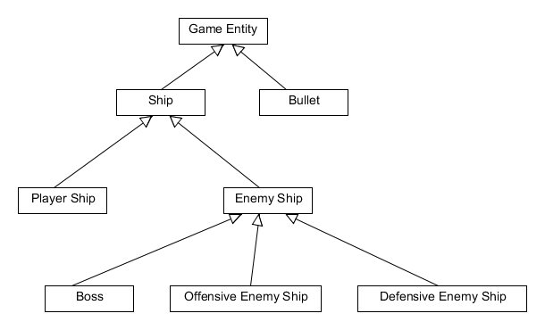
Hierarchy Inheritance

Slide 5
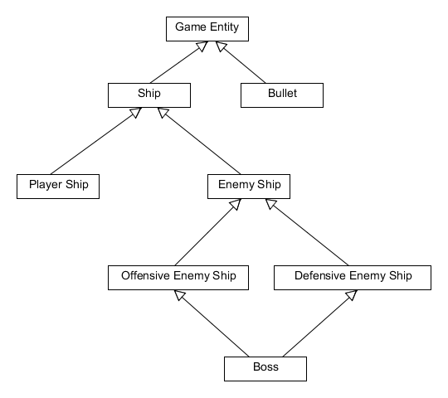
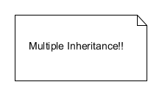
Hierarchy Inheritance

Slide 6
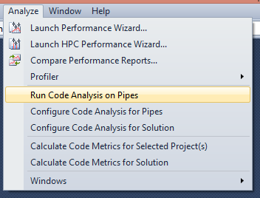
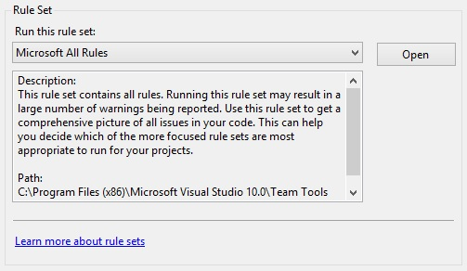
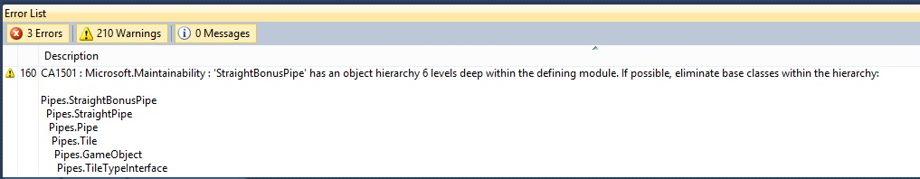
Static Code Analysis

Slide 7
Hierarchy Structures
Pros
Polymorphism
Code reuse
Cons
Deep hierarchy levels, hard to manage/debug
Code repetition (usually in wide hierarchies)
Inherited unnecessary functionality

Slide 8
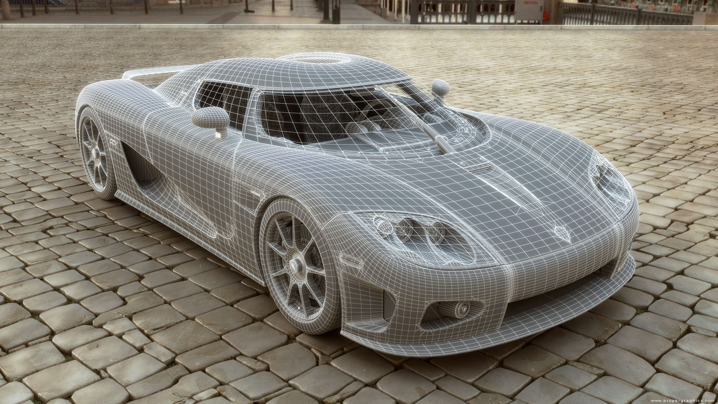
Thinking With Components

Slide 9
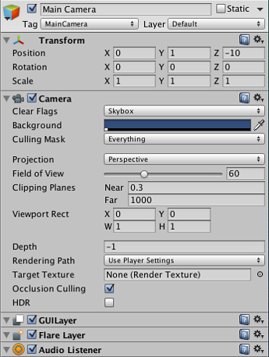
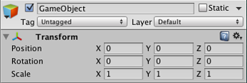

GameObject - Component

Slide 10
Entity Component System (ECS)
Entity
Component
System

Slide 11

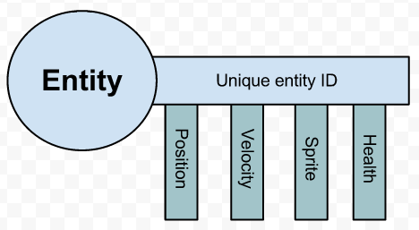
Entities and Components
GameObject Actor, Pawn

Slide 12
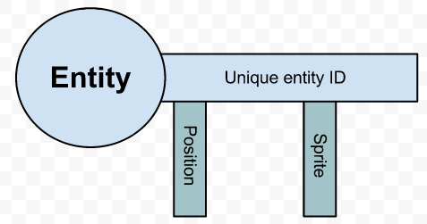
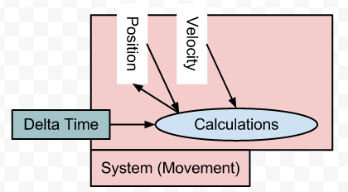
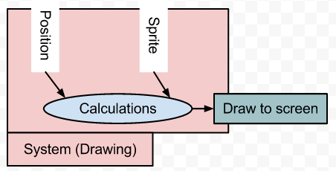
Systems

Slide 13
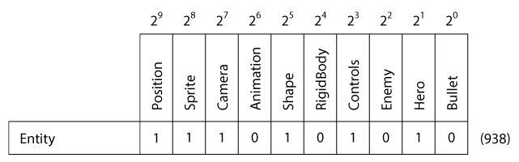
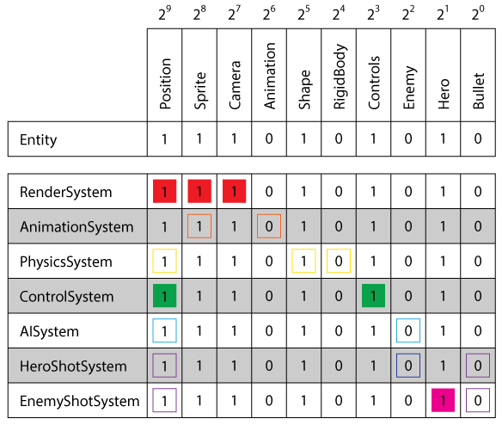
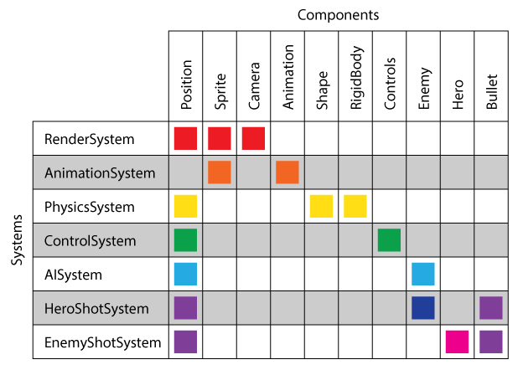
ECS Example

Slide 14
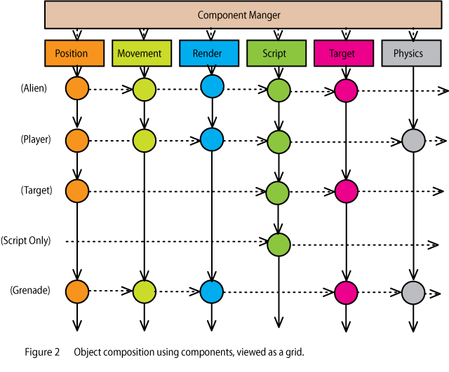
ECS Example 2

Slide 15
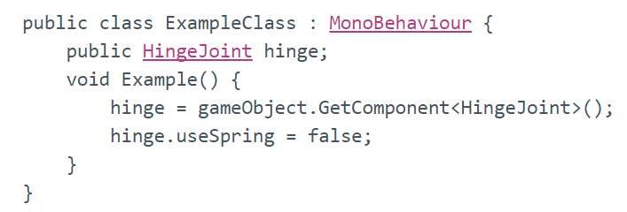
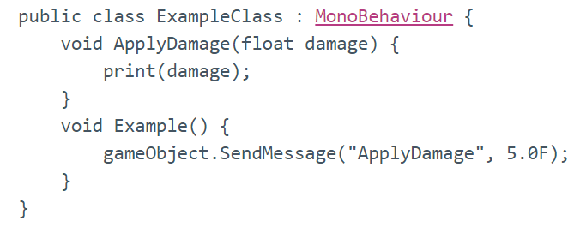
Component Communication
Get Component
Sending Messages

Slide 16
OUR IMPLEMENTATION

Slide 17
Component Implementation
Every distinct Component has a unique ID
Can contain data and functionality
Component class methods:
Initialize
Update
Draw

Slide 18
Entity Implementation
We group entities of the same type
Some class methods:
Update
Draw
AddGroup
AddComponent
Communication is implemented with
GetComponent

Slide 19
Entity Manager Implementation
Some class methods:
Update
Draw
AddToGroup
Refresh

Slide 20
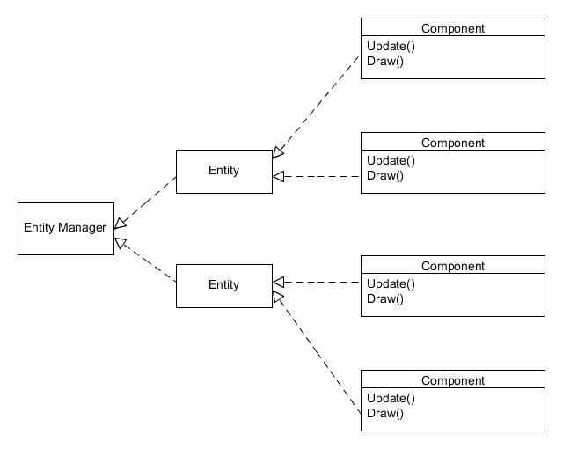
Implementation Diagram

Slide 21

Entity: Player Ship
Needed Components:
Transform
Physics
Player Controller
Rectangle Renderer

Slide 22
Entity: Bullets
Needed Components:
Transform
Physics
Rectangle Renderer

Slide 23

Entity: Defensive Enemy Ship
Needed Components:
Transform
Physics
Rectangle Renderer

Slide 24

Entity: Offensive Enemy Ship
Needed Components:
Transform
Physics
Weapon AI Controller
Rectangle Renderer

Slide 25
DEMO

Slide 26
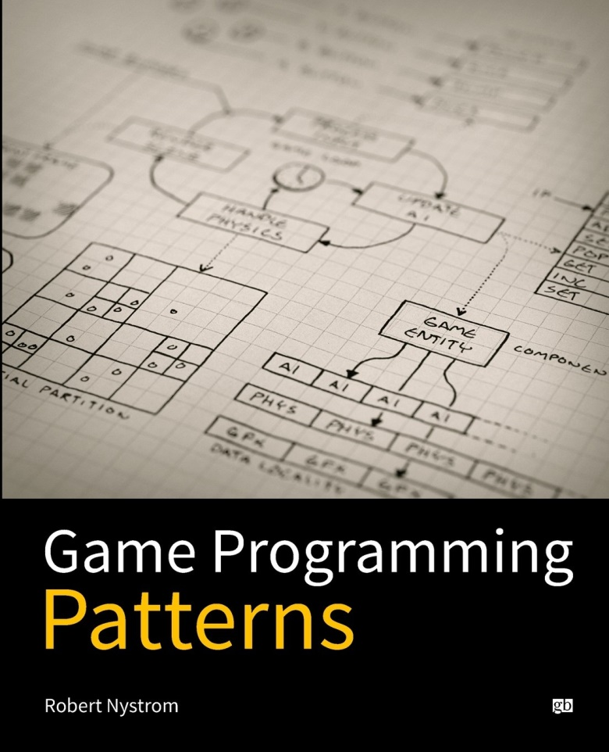
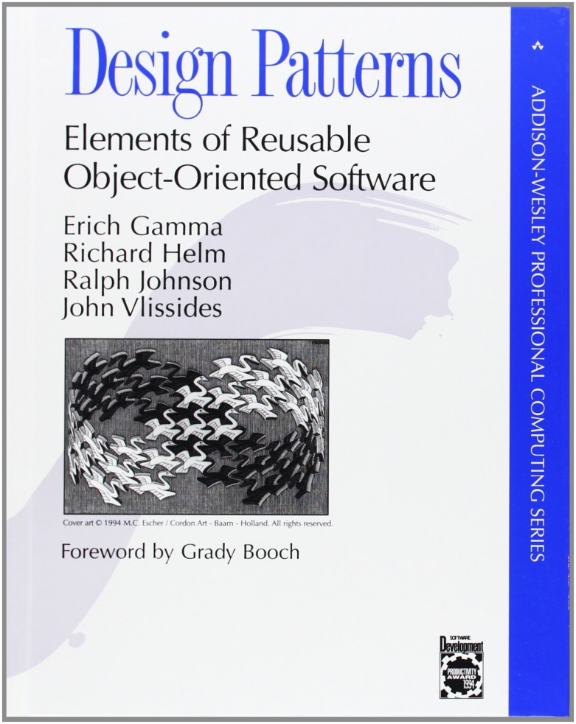
Book References

Slide 27
References
Evolve Your Hierarchy http://cowboyprogramming.com/2007/01/05/evolve-your-heirachy
Component Pattern (C++)
http://gameprogrammingpatterns.com/component.html
Dive into C++11
https://www.youtube.com/playlist?list=PLTEcWGdSiQenl4YRPvSqW7UPC6SiGNN7e
Entity Component System
http://en.wikipedia.org/wiki/Entity_component_system

Slide 28
References
Entity Systems Wiki
http://entity-systems.wikidot.com
Entity/Component Game Design: A Primer
http://piemaster.net/2011/07/entity-component-primer
What is an entity system framework for game development? (ActionScript)
http://www.richardlord.net/blog/what-is-an-entity-framework
Game Object Structure: Inheritance vs. Aggregation
http://gamearchitect.net/Articles/GameObjects1.html

Slide 29
References
Game Development Design (Part 1 & 2)
http://stefan.boxbox.org/game-development-design
Entity Systems are the future of MMOG development (Multiple Parts)
http://t-machine.org/index.php/2007/09/03/entity-systems-are-the-future-of-mmog-development-part-1
Component Based Engine Design (C++)
http://www.randygaul.net/2013/05/20/component-based-engine-design
How to Build an Entity Component System Game in JavaScript
http://vasir.net/blog/game-development/how-to-build-entity-component-system-in-javascript

Slide 30
References
Game Engines 101: The Entity/Component Model
http://www.gamasutra.com/blogs/MeganFox/20101208/88590/Game_Engines_101_The_EntityComponent_Model.php
A Data-Driven Game Object System (pdf)
http://scottbilas.com/files/2002/gdc_san_jose/game_objects_slides.pdf
Component-based game object system
https://github.com/surjikal/cbgos-experiment
Avoiding the Blob Antipattern: A Pragmatic Approach to Entity Composition
http://gamedevelopment.tutsplus.com/tutorials/avoiding-the-blob-antipattern-a-pragmatic-approach-to-entity-composition--gamedev-1113

Slide 31
References
Understanding Component-Entity-Systems http://www.gamedev.net/page/resources/_/technical/game-programming/understanding-component-entity-systems-r3013
Implementing Component-Entity-Systems
http://www.gamedev.net/page/resources/_/technical/game-programming/implementing-component-entity-systems-r3382
Case Study: Bomberman Mechanics in an Entity-Component-System
http://www.gamedev.net/page/resources/_/technical/game-programming/case-study-bomberman-mechanics-in-an-entity-component-system-r3159
A Critique of the Entity Component Model
http://www.gamedev.net/page/resources/_/technical/game-programming/a-critique-of-the-entity-component-model-r3621

Slide 32
References
ECS Articles
http://www.alecmce.com/blog
Component based game engine design
http://stackoverflow.com/questions/1901251/component-based-game-engine-design/3495647#3495647
Role of systems in entity systems architecture
http://gamedev.stackexchange.com/questions/31473/role-of-systems-in-entity-systems-architecture/31491#31491
How does the Unity3D entity system work?
http://gamedev.stackexchange.com/questions/72962/how-does-the-unity3d-entity-system-work

Slide 33
References
How to write solid Pure Aggregation (composition) Game Objects in Java?
http://stackoverflow.com/questions/5546711/how-to-write-solid-pure-aggregation-composition-game-objects-in-java
Is the Entity Component System architecture object oriented by definition?
http://programmers.stackexchange.com/questions/211708/is-the-entity-component-system-architecture-object-oriented-by-definition
Kenny Art Assets
http://kenney.nl/assets

Slide 34



Thank you!
GCoder.gr
Dimitris Evgenidis (GCodergr)
gcoder.gr@gmail.com

